Slide 1
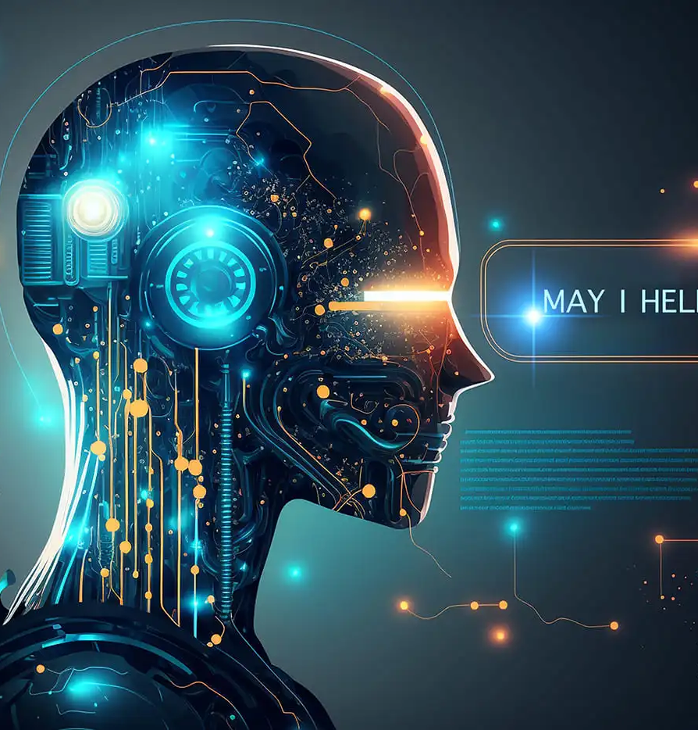
The Beauty of AI:Chatbot
From Code to Chat:Creating a Rock ,Paper,Scissors Game with a Telegram Bot
Presented by: Dorzea Lyse

Slide 2


Brief History of Chatbot
Chatbots started in 1966 with ELIZA, a simple program simulating a therapist through pattern-matching. In 1972, PARRY added emotional modeling, advancing the realism of chatbot conversations. The 1990s introduced ALICE, using AIML to handle more complex dialogues, followed by SmarterChild in 2001, which brought chatbots to instant messaging. By 2010, Siri launched as Apple’s AI assistant, followed by Alexa and Google Assistant, incorporating voice recognition and machine learning. Today’s chatbots, powered by models like GPT, generate human-like, context-aware responses, marking the height of conversational AI’s evolution.

Slide 3
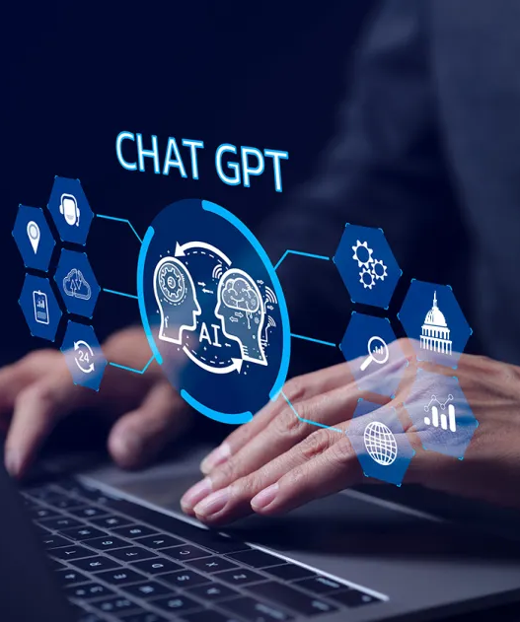
Introduction to Chatbot and Telegram Bot
What is a ChatBot
CHATBOT: A chatbot is software designed to simulate conversation with human users.
What is a Telegram Bot?
A Telegram bot is a specialized chatbot built to operate within Telegram. It uses the Telegram Bot API to interact with users on Telegram through messages, commands, and various media (images, files, etc.).

Slide 4
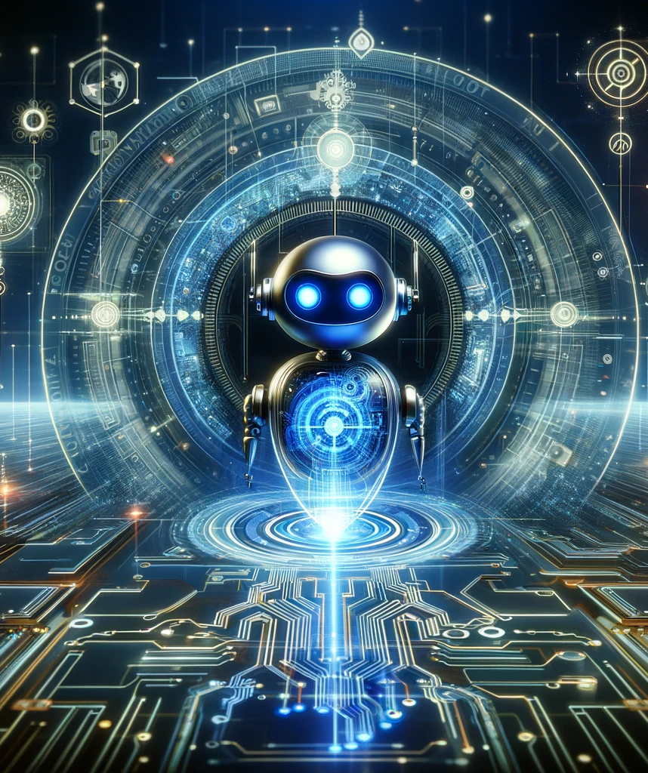
Technology Behind The Creation Of Chatbots
Natural Language Processing (NLP): NLP is essential for chatbots to understand user inputs. It breaks down sentences, recognizes intent, and extracts keywords to determine what the user is asking, allowing the chatbot to provide relevant responses.
Machine Learning (ML): ML allows chatbots to learn from past conversations, improving their responses over time. With ML, chatbots can predict user needs based on previous interactions and provide more accurate and helpful aanswers, even in complex situations.
Rule-Based Logic: Rule-based systems use pre-defined conditions to guide responses. For example, if a user types "Hi," the chatbot may have a specific programmed response, like "Hello! How can I help you today?" This approach works well for simple tasks but lacks flexibility for broader conversations.
APIs and Integration: Chatbots connect to other systems and data sources through APIs (Application Programming Interfaces). This enables them to pull in information, such as weather data, product details, or user account info, providing richer responses without needing to store everything internally.
User Interface (UI): Chatbots are designed to work in messaging platforms (like Telegram or WhatsApp) or websites, providing a familiar and accessible interface. They often use buttons, quick replies, and rich text options to make conversations smoother and more engaging.

Slide 5
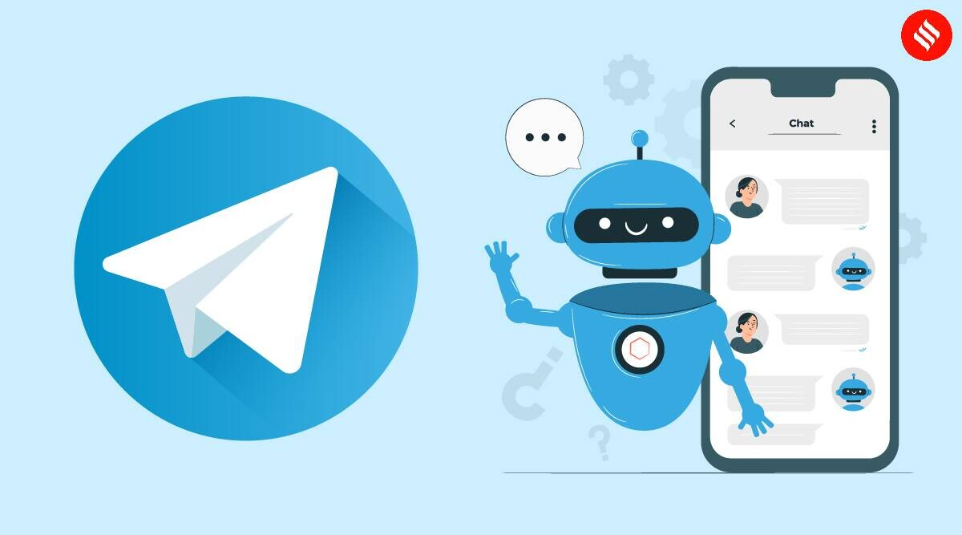
How to create a bot on Telegram
Install the Telegram App
Set Up a Telegram Account
Use @BotFather to Create Your Bot
Choose a Name and Username for Your Bot
Get Your Bot Token
Configure Bot Settings (Optional)
Set Up a Development Environment

Slide 6
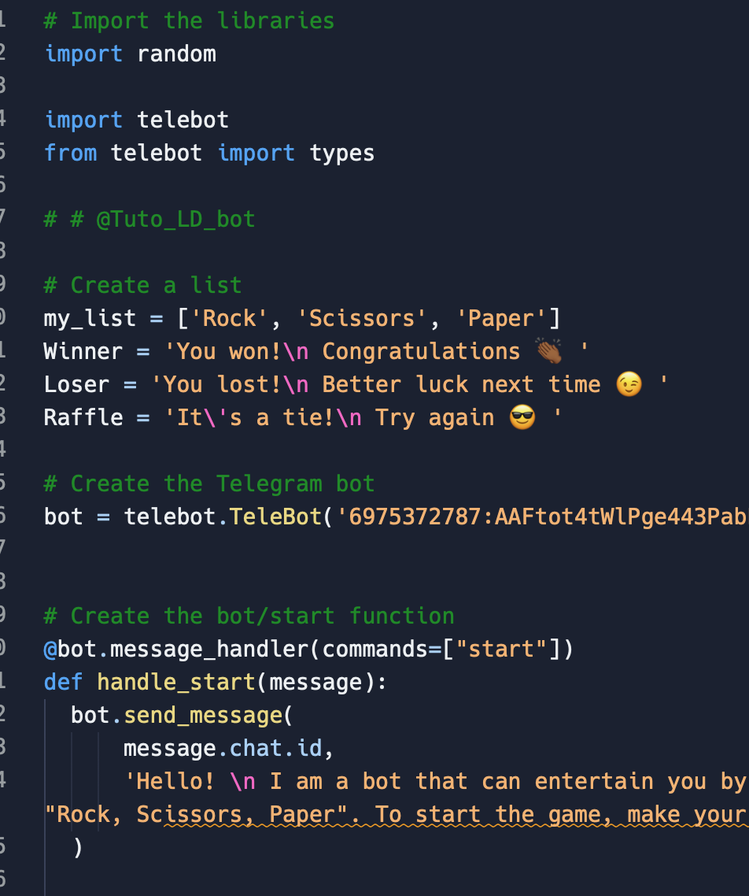
Tools Used For The Project
Python Programming Language
Purpose: Python is the main programming language used to write the bot’s code due to its simplicity and extensive libraries for building bots.
Telebot Library (PyTelegramBotAPI)
Purpose: This library provides a simple interface to the Telegram Bot API, allowing us to handle messages, commands, and interactions with users more efficiently.
Telegram Bot API
Purpose: The API allows the bot to communicate with Telegram’s servers, enabling real-time message exchanges and interaction with users.
Random Library
Purpose: This standard Python library generates random choices in the Rock, Paper, Scissors game.
Telegram Botfather
Purpose: Botfather is a tool within Telegram used to create new bots and obtain the unique bot token required for authorization.

Slide 7
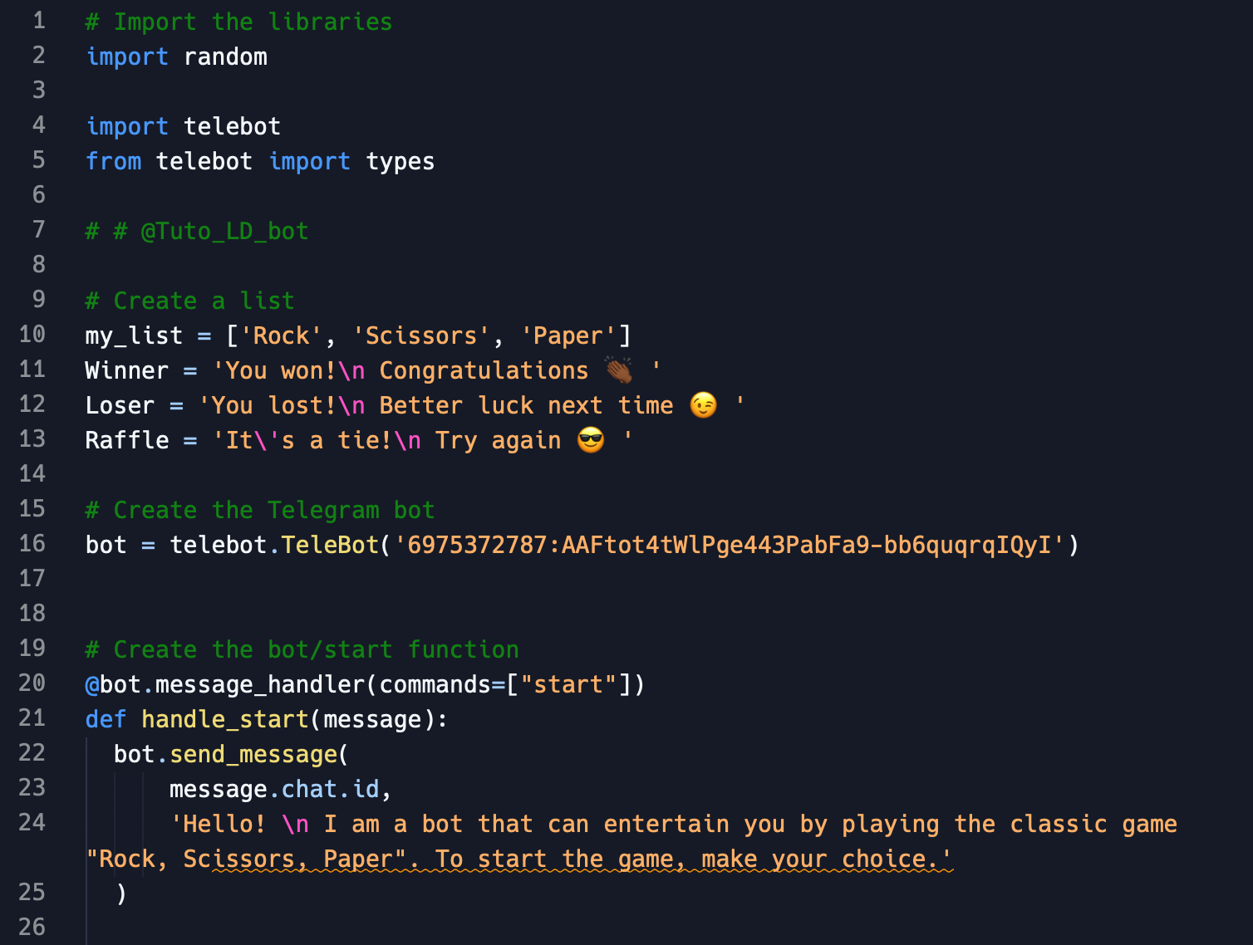

Slide 8
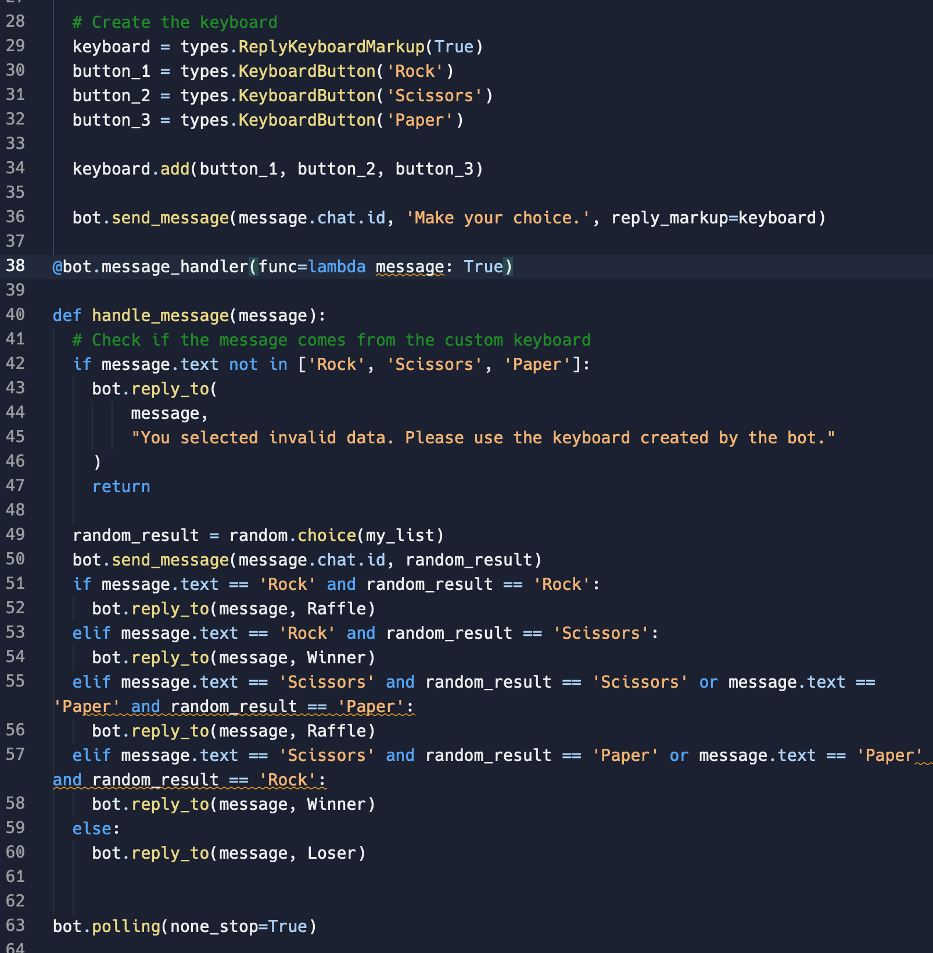

Slide 9
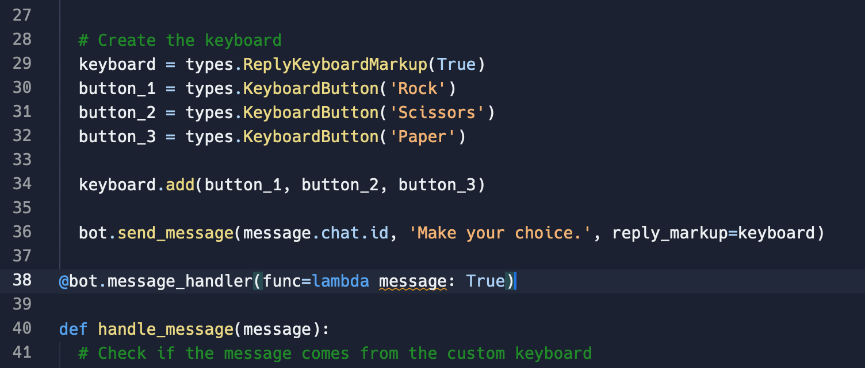

Slide 10
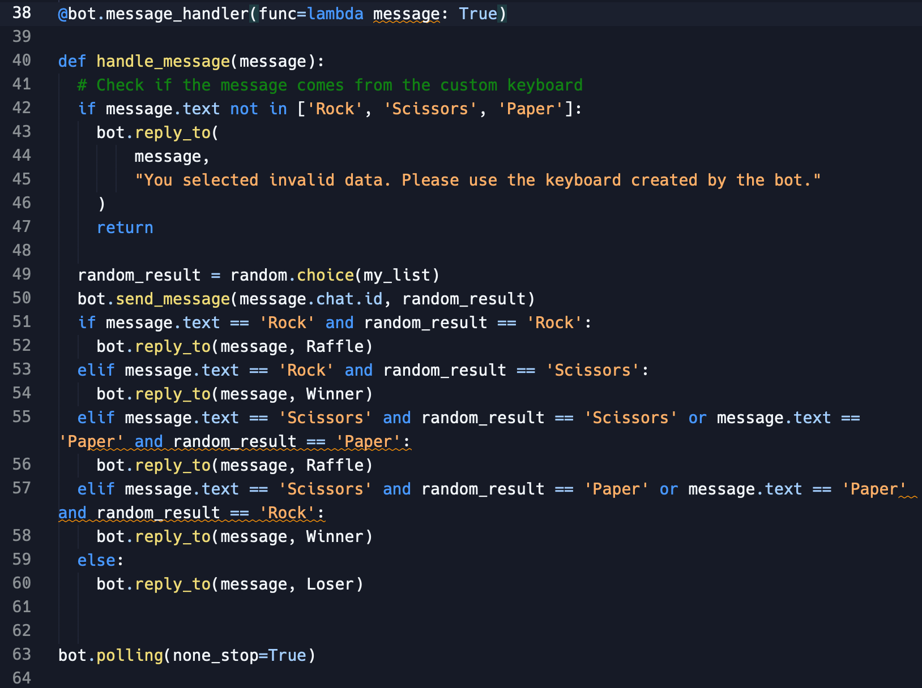

Slide 11
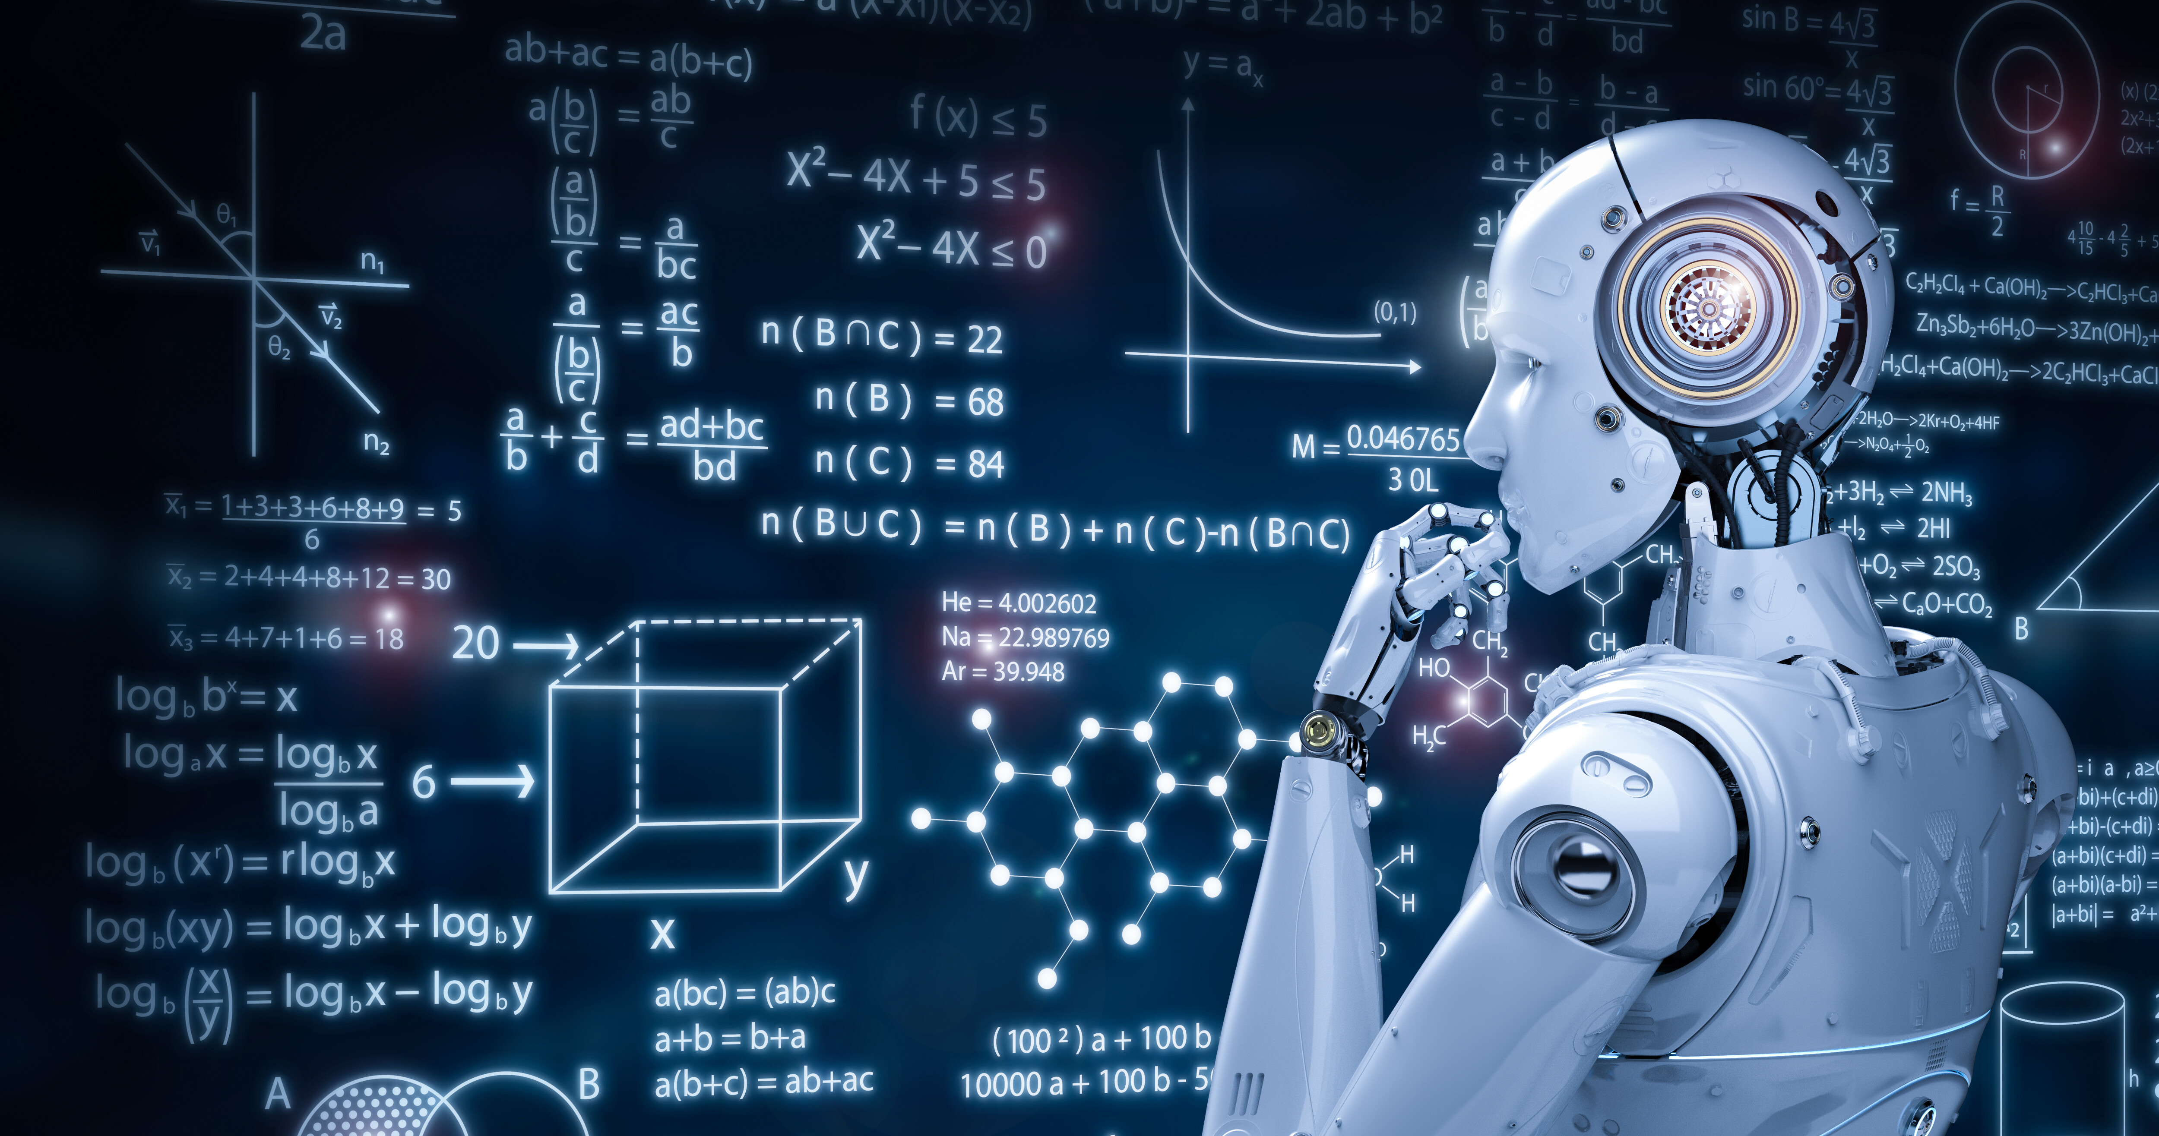
Challenges Faced During Code Development
Designing the logic for the "Rock, Scissors, Paper" game
Creation of a customized keyboard

Slide 12

Improvements Made To The Code
To enhance the game logic, I conducted tests by playing against the bot myself, which allowed me to validate the rules and ensure a consistent user experience. Regarding the custom keyboard, I added an automatic error message function to notify the user whenever they attempted to select an option not available on the bot-generated keyboard. This improvement enhances interaction and ensures a more intuitive bot usage.

Slide 13
Conclusion
Developing this Telegram bot for the "Rock, Scissors, Paper" game offered valuable insights into both the practical and conceptual aspects of creating interactive applications. Throughout the project, I strengthened my understanding of Telegram's Bot API, particularly in handling user inputs and managing custom keyboards to enhance the user experience. Designing the game’s logic within the context of bot interactions honed my skills in implementing conditional logic and response handling, ensuring a smooth and engaging user experience.
One of the most rewarding aspects was learning to anticipate user behavior and handling errors gracefully when inputs deviated from expected responses. This project underscored the importance of robust input validation in interactive applications, an essential skill for any developer working with user-facing technologies.
Looking ahead, I see several promising enhancements to enrich this project further. Future improvements could include adding a scoring system to track user performance over multiple rounds, implementing game statistics, or even introducing new game modes to diversify the bot’s offerings. Additionally, I’m considering integrating this bot into a web or mobile platform, making it accessible across various mediums. This project has laid a solid foundation, and I’m excited to explore its potential for further development.

Slide 14

Thank You

